Slide 1

Project Name:
Selected Theme: Green Energy generation, transmission,
and storage
Team Name: ReVolt Dynamics
Team ID: AG24-14001382
Team Leader E-mail ID: 2022meb1306@iitrpr.ac.in
Final Design Submission

Slide 2




Team Name
Name : Dharmansh Vyas Title : Team Lead
Name : Hardik Jain
Title : Research&Consulation
Name : Charukant Title : Data Analytics & Calculations
Name : Janhvi Soni Title : Design & Simulation
Notes:
Team Name:
Write your team members name.
Your role in the team (Designer/Team Leader/Marketing/Innovator).
Your Email ID used for the registration.

Slide 3

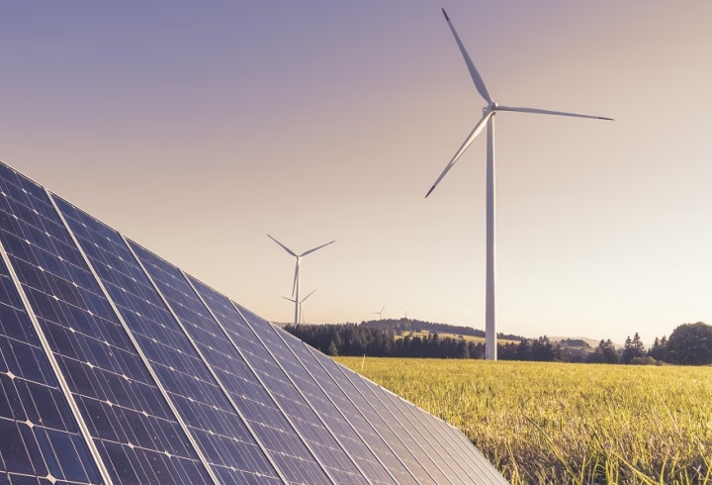
Problem Identified
PROBLEM DESCRIPTION
In the year 2022, the world consumed about 25,000 terawatt-hours of electrical energy, 60 % percent of which was generated by coal and gas. This shows that despite increasing awareness about green energy and heavy investments, renewable resources are yet to catch up with fossil fuels. With the depletion of these fossil fuels and the ever-increasing demands, we are eventually going to run out of coal and petroleum. Fossil fuels also cause huge carbon emissions as well, from their mining to their burning. To combat these problems, we need to switch to renewable energy quickly and widely. We need to tap into every possible place and form of these renewable energies.
Representative images of the problem you would like to solve
Background:
Background of the problem: The percentage of electrical energy currently generated using renewable resources is very low, and most of the energy comes from non-renewable sources. This needs to be reversed, and renewable energy should be the major contributor to global energy production. There are many challenges in achieving this, including a lack of widespread implementation of available technology, geographical limitations and economic constraints.

Slide 4

Problem Identified
Societal context: In the current social context, people are increasingly aware of the environmental impact of their energy consumption. There is a growing concern about climate change, pollution, and the depletion of natural resources, which has led to a heightened demand for sustainable and eco-friendly solutions. As the global community becomes more aware of these issues, there is a growing societal expectation for innovative solutions that can mitigate the environmental impact while meeting energy demands. However, the transition to renewable energy is often seen as challenging, not only because of technological and economic barriers but also due to societal inertia and the need for widespread behavioral change. People are caught in a paradox where they desire cleaner energy but are constrained by existing infrastructure, financial limitations, and the uneven distribution of renewable resources.
Existing Solutions:-
Distributed Energy Resources (DERs): Small-scale, decentralized energy production systems like rooftop solar panels, wind turbines, and microgrids allow for energy generation closer to the point of use, reducing transmission losses and dependence on large power plants.
Representative images of the problem you would like to solve

Slide 5
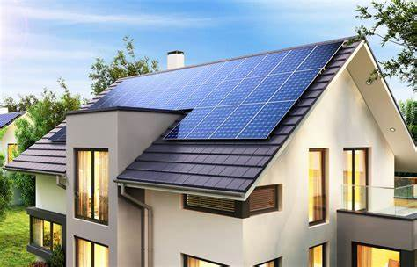
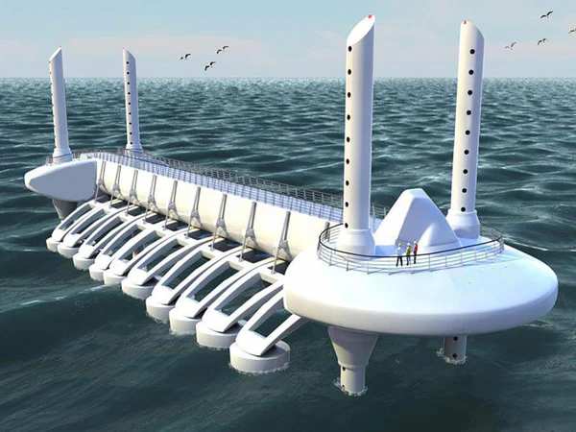
Problem Identified
Policy and Incentives: Government policies and incentives, such as feed-in tariffs, tax credits, and subsidies for renewable energy installations, help promote the adoption of clean energy technologies by making them more financially viable for individuals and businesses. For example, the Government of India has launched Grid Connected Rooftop Solar Programme To achieve a cumulative installed capacity of 40,000 MW from Grid Connected Rooftop Solar (RTS) projects.
Geothermal and Ocean Energy: While still underutilized, geothermal and ocean energy offer renewable energy alternatives that are less dependent on geographical conditions like solar and wind. These sources can provide more consistent energy generation in suitable locations.
Representative images of the problem you would like to solve

Slide 6

Significance
WHY IS IT AN URGENT PROBLEM?
The issue of limited and inefficient renewable energy generation, especially in areas with geographical constraints, is urgent due to several pressing factors like severe impact of fossil fuels on climate change which is evidenced by severe weather events, rising sea level, biodiversity loss along with rapid depletion of finite resources and health risks from the pollution. These led to a major call for transition to renewable energy sources.
Importance of Solving the Problem:
Environmental Protection: Transitioning to renewable energy helps reduce carbon emissions, combat climate change, and protect ecosystems. This action is critical for the health of the planet and the preservation of natural habitats.
Sustainable Resource Use: Renewable energy sources are abundant and replenishable, ensuring that future generations have access to clean energy without depleting the planet's resources. This promotes long-term sustainability and energy security.
Economic Benefits: Investing in renewable energy can stimulate economic growth by creating new industries and jobs. It also leads to cost savings by reducing dependence on imported fossil fuels and minimizing environmental damage costs.
Public Health Improvement: Reducing pollution from conventional energy sources improves air quality and public health, leading to healthier living conditions and a higher quality of life for communities.

Slide 7
Significance
Societal Benefits:
Emotional Impact: Addressing environmental and health concerns fosters a sense of security and well-being among communities, knowing they are contributing to a cleaner, healthier future.
Financial Impact: Transitioning to renewable energy can lead to substantial economic savings over time, reduce energy costs, and create new job opportunities in the green energy sector. Decentralization of energy generation will significantly reduce transmission costs and promote sustainable development.
Social Impact: By implementing innovative renewable energy solutions that eradicate geographical constraints, we can promote equality in energy and access for remote areas, support social development, and ensure a fair transition to a sustainable energy future for all communities.

Slide 8
Research findings
1. Helical Savonius Rotor vs. Two-Stage Savonius Rotor:
- The study compared the aerodynamic performance of a helical Savonius rotor with twisted blades to a two-stage Savonius rotor with conventional "S" shaped blades.[1]
- The helical Savonius turbine demonstrated more stable torque generation and less oscillation in performance, resulting in a higher overall power coefficient, making it ideal for consistent energy production in low wind-speed environments.[1]
2. Static and Dynamic Torque:
- Positive Static Torque: The helical turbine showed a positive static torque coefficient for all rotor angles, ensuring the turbine starts rotating with minimal wind.[2]
- Stable Dynamic Torque: The dynamic torque coefficient of the helical Savonius turbine was less variable during rotation compared to the two-stage turbine, making it more reliable under fluctuating wind speeds[2]
3. Tip Speed Ratio (TSR):
- The optimal TSR for the helical Savonius turbine was 0.65, at which the turbine produced the highest efficiency and power output. Lower TSR values yielded higher torque but less power, whereas higher TSR values reduced both torque and power output[2]
- Wind Power Optimization: The findings from this paper suggest that using a three-bladed Savonius turbine with optimized blade geometry (such as overlapping blades and end plates) can further enhance the turbine's ability to operate efficiently in low wind speeds. This is particularly useful for your application where wind speeds may fluctuate.[2]
- Steady Power Output: The smooth torque generated by Savonius turbines would provide a more consistent power output, ideal for energy harvesting from passing vehicles on highways or roadside environments with variable wind conditions.[1]

Slide 9
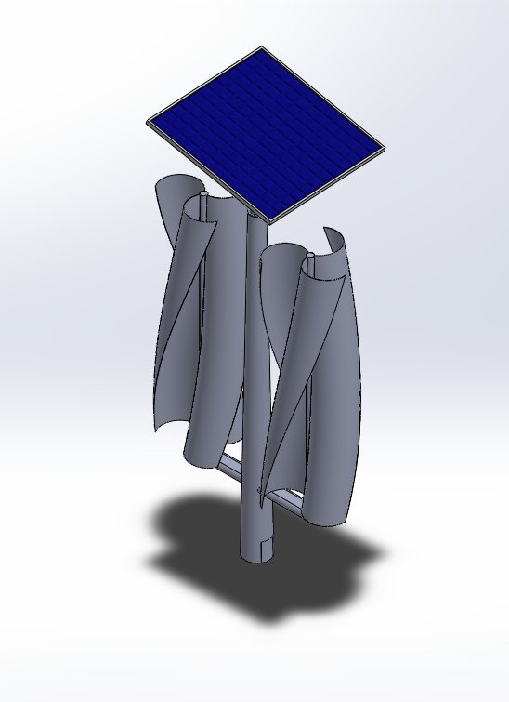
Final solution & Innovation
Solution: A hybrid energy system combining wind turbines and solar panels, harnessing vehicle induced wind and sunlight for continuous power generation.
Benefits: Provides reliable energy in areas lacking ideal conditions (low wind speeds or inconsistent sunlight) such as highways. Users achieve green energy generation with minimal geographical limitations.
Unique Features: Utilizes traffic induced wind, making it innovative and suitable for roadside applications where conventional wind turbines are ineffective. The modular design enhances scalability and cost efficiency.
Usability and Feasibility: The system is easily deployable along highways, adaptable to various traffic conditions, and maximizes energy output while decentralizing power generation.
Notes:
Rendered images of your 3D CAD model. You can also add the final product images if you have created any prototype.
Details of your product functionality such as (Benefits/Advantages/Uses)

Slide 10
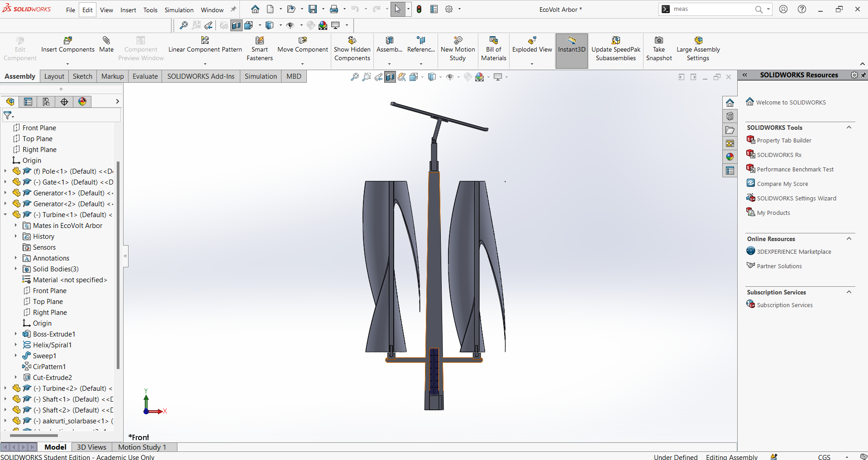
Final CAD Product Images
Section View
Notes:
Please render your model and add good images of your final product. You can add the slides if you want to show the part and assembly details of your product.

Slide 11
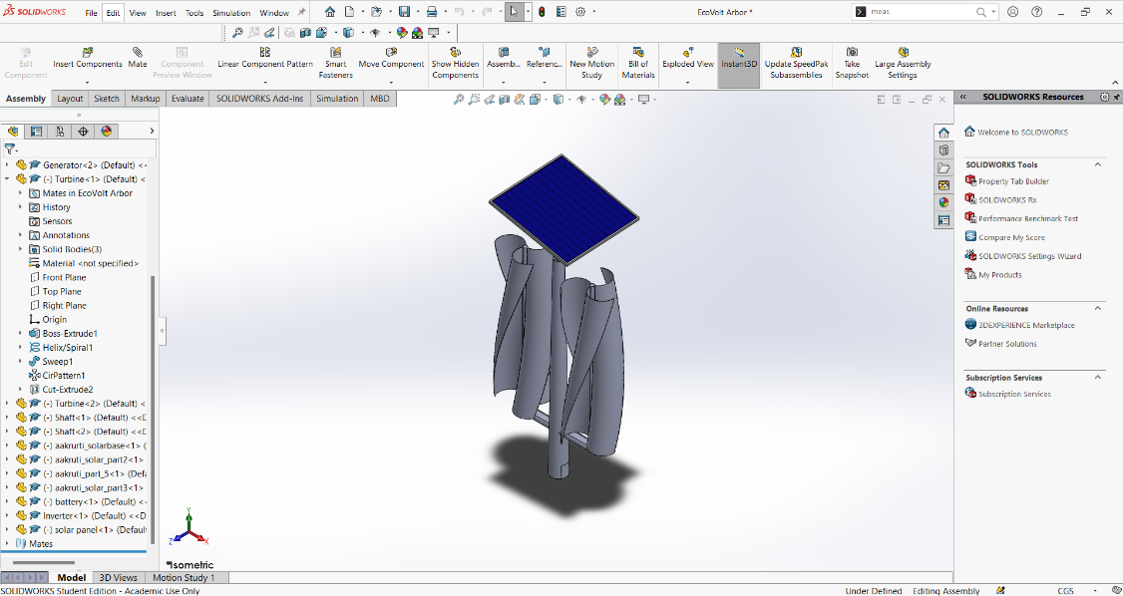
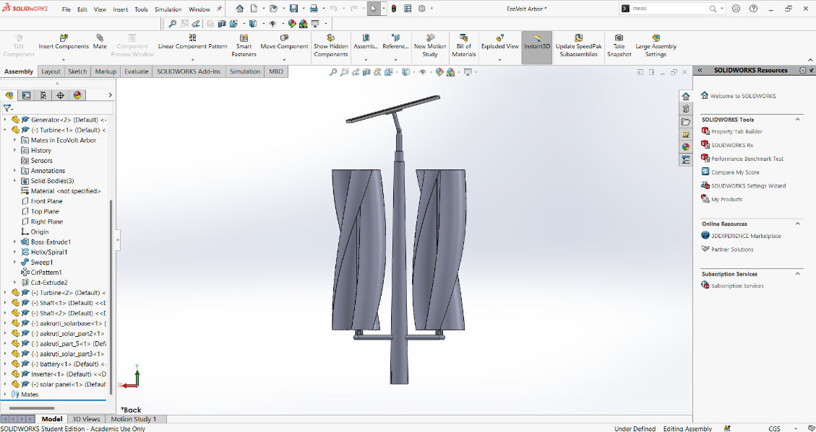
Final CAD Product Images
Different views of the product
Notes:
Please render your model and add good images of your final product. You can add the slides if you want to show the part and assembly details of your product.

Slide 12
Product Design Specifications
Based on the provided cost breakdown and the request for filling in the following sections:
Components required:
Solar panel (1 m²)
Six wind turbine blades
Two turbine central shafts
Dynamo (2 units)
Solar panel motion mechanism
Main body structure
Assembly labor
Welding tools
Technical requirements:
Wind turbines must be able to operate with lowspeed winds generated by passing vehicles.
Solar panel efficiency must be sufficient to generate consistent energy (20% efficiency).
A robust and durable structure to withstand outdoor conditions, mounted on highway barriers.
Motion mechanism to adjust the solar panel for optimal sunlight capture.
Human factors requirements:
Easy installation and maintenance access for periodic checks and repairs.
Minimal supervision postinstallation, requiring basic training for maintenance personnel.
The design should ensure safety for both workers during installation and vehicles passing by.
Constraints:
The total system cost must not exceed ₹100,000.
Energy generation is dependent on traffic flow for wind turbines and sunlight availability for solar panels.
Limited space for installation along road barriers, which may constrain the size of components.
Durability of the system under varying weather conditions (rain, wind, dust) must be considered for longterm use.

Slide 13
Product Details
The hybrid energy system combines wind and solar energy to generate continuous power, designed specifically for roadside installations like highway barriers.
Wind Turbine Mechanism:
Number of Turbines: 2 verticalaxis Savonius turbines.
Number of Blades: 6 blades (3 blades per turbine).
Blade Area: 4808 cm² per blade, totaling 28,848 cm².
Projected Area: 4500 cm² per blade, totaling 27,000 cm².
Dynamo: 2 units, each rated at 500 W, converting mechanical energy from turbines into electrical energy.
Solar Panel Mechanism:
Panel Size: 1 m² with monocrystalline photovoltaic cells.
Efficiency: 20%, generating up to 200 W under optimal sunlight conditions.
Tracking Mechanism: Includes a motion system to adjust panel orientation for maximum sunlight capture.
Product Structure:
The turbines and solar panel are mounted on a durable and modular frame, designed for easy installation and scalability along roadways. The system is optimized for continuous energy generation using vehicleinduced wind and solar power.

Slide 14

Product Reflection
Benefits:
Utilizes vehicle induced wind, eliminating reliance on high wind speeds.
Ensures continuous energy generation through hybrid solar and wind integration.
Modular and scalable, adaptable to various road and highway conditions.
Provides a cost effective renewable energy solution within a ₹100,000 budget.
Contributes to environmental sustainability by using clean energy sources.
Drawbacks:
Lacks efficient energy storage for excess power.
Wind energy generation depends on traffic flow.
Limited solar panel size may reduce solar output in low sunlight areas.
Requires improved structural durability and maintenance.
Turbine performance could be optimized for low traffic areas.
Notes:
Explain the benefits of your product over the current market solution.

Slide 15

Design Process
Research:
We focused on developing a hybrid energy system utilizing both wind and solar energy. For wind energy, we selected two wind turbines, each with three blades, resulting in a total of six blades. The area for one blade is 4808 cm², giving a total blade area of 28,848 cm², and the total projected area is 27,000 cm². These turbines were optimized to use the airflow generated by passing vehicles, eliminating the need for highspeed wind conditions. A 1 m² solar panel was chosen to capture solar energy efficiently. The key considerations included optimizing wind energy from traffic, ensuring effective solar energy collection, and system scalability along highways.
Reframed Design Brief:
From the start, our goal was to create a hybrid system within a ₹100,000 budget. The design included two wind turbines with a total blade area of 28,848 cm² and a projected area of 27,000 cm², along with a 1 m² solar panel. The system was designed to harness wind from passing vehicles and solar energy, ensuring continuous energy generation with minimal reliance on high wind speeds or optimal sunlight.
Ideation and Concept Selection: We explored several configurations:
A solar only setup
A wind only setup using the Savonius turbines
A hybrid system combining both wind and solar energy
The hybrid system was selected for its ability to provide continuous power generation. It was designed to balance wind and solar energy, maximizing efficiency by taking advantage of traffic induced wind and sunlight.
Final Solution Development: The final design included two three bladed Savonius wind turbines and a 1 m² solar panel. The wind turbines harness energy from passing vehicles, ensuring consistent power generation even in low wind environments. The solar panel was optimized for daily sunlight exposure. The design met budget constraints while ensuring scalability and maximum energy output for deployment along highway barriers.

Slide 16

Impact of your solution
Promotes Sustainability: The hybrid energy system supports the transition to green energy by utilizing renewable wind and solar resources, reducing reliance on fossil fuels.
Environmental Impact: By harnessing traffic induced wind and sunlight, the system helps lower carbon emissions, contributing to a cleaner environment.
Energy Accessibility: The decentralized nature of the system allows energy generation in nonideal geographical areas, making power more accessible to remote or urban locations without major infrastructure.
Cost Savings: Users benefit from reduced energy costs by utilizing renewable energy sources, which have lower long term operational costs.
Societal Impact: Encourages the adoption of sustainable technologies, positively influencing societal energy consumption habits and awareness of renewable solutions.

Slide 17
Impact of your solution
Environmental Impact
CO₂ Reduction: Assuming the carbon intensity of grid electricity is 0.5 kg CO₂ per kWh, the reduction in CO₂ emissions from the generated energy is:
CO₂ savings per year = 400.3 kWh/year × 0.5 kg CO₂/kWh = 200.15 kg CO₂ per year
Over the lifetime of 25 years:
Total CO₂ savings = 200.15 kg CO₂/year × 25 years = 5003 kg CO₂

Slide 18

Sustainability
Environmental Impact: Our hybrid energy system utilizes wind and solar power, reducing reliance on fossil fuels and cutting carbon emissions. It harnesses natural, renewable resources, contributing to a cleaner and healthier planet.
Long-Lasting Solution: Designed with durable materials and minimal moving parts, the system is resilient and requires low maintenance, ensuring long-term sustainability. Its modular structure also allows for easy upgrades and scalability over time.
Social Sustainability: The system decentralizes energy production, making power accessible in remote areas or urban spaces with limited infrastructure, thereby supporting energy equity.
Ecological Benefits: By using traffic-induced wind and sunlight, the system taps into underutilized energy sources without disrupting the natural environment. This minimizes ecological footprints compared to conventional energy systems.
Economic Sustainability: The hybrid system is cost-effective over time, with reduced operational expenses due to the use of renewable energy. It also promotes energy savings for users, helping reduce reliance on costly traditional power grids.
Notes:
You can use the sustainability tool provided in the Solidworks or 3DExperience platform . If you don’t have access to the tools please contact your mentors on the community.

Slide 19
Sustainability
NET SUSTAINABLE POWER GENERATION
Power from wind = (1/2) air density area wind speed^3 power coefficient
Where:
- Air density = 1.225 kg/m³
- Projected area of the turbine blades = 0.45 m² based on your design
- Wind speed = 5 m/s (based on typical highway conditions)
- Power coefficient = 0.35 (typical for vertical-axis wind turbines)
Substituting the values:
Power from wind = (1/2) 1.225 0.45 (5)^3 0.35 = 12.1 W
Daily Energy from Wind: Assuming the wind turbine operates for 8 hours per day due to passing vehicles:
Daily energy from wind = 12.1 W 8 hours = 96.8 Wh/day
Annual energy from wind = 96.8 Wh/day 365 days = 35,332 Wh/year = 35.3 kWh/year
Notes:
You can use the sustainability tool provided in the Solidworks or 3DExperience platform . If you don’t have access to the tools please contact your mentors on the community.

Slide 20
Sustainability
Solar Panel Power Generation
Formula: The power generated by a solar panel is given by:
Power from solar = panel area solar irradiance efficiency
Where:
- Panel area = 1 m² (based on your design)
- Solar irradiance = 1000 W/m² (typical value for peak sunlight)
- Efficiency = 0.2 (20%, typical for modern panels)
Notes:
You can use the sustainability tool provided in the Solidworks or 3DExperience platform . If you don’t have access to the tools please contact your mentors on the community.

Slide 21
Sustainability
Substituting the values:
Power from solar = 1 m² 1000 W/m² 0.2 = 200 W
Daily Energy from Solar: Assuming 5 hours of peak sunlight per day:
Daily energy from solar = 200 W 5 hours = 1000 Wh/day
Annual Energy from Solar: Over a year:
Annual energy from solar = 1000 Wh/day 365 days = 365,000 Wh/year = 365 kWh/year
Total Annual Energy Generation
For one wind turbine and one solar panel:
Total annual energy = 35.3 kWh/year (wind) + 365 kWh/year (solar) = 400.3 kWh/year
This meets our goal for a sustainable future.
Notes:
You can use the sustainability tool provided in the Solidworks or 3DExperience platform . If you don’t have access to the tools please contact your mentors on the community.

Slide 22

Business Viability
Monetary Value in Rupees
Annual Energy Generation: 400.3 kWh/year
Electricity Cost in Rupees: ₹8.30 per kWh (this is an assumed electricity rate, you can adjust it as per your local rates)
Now, let's calculate the monetary value:
Monetary Value = 400.3 kWh/year × ₹8.30 per kWh = ₹3,322.49 per year
So, the system will save approximately ₹3,322.49 per year.
Installation Costs and Payback Period in Rupees
Total Prodct Cost as per calclatios : ₹25000
Installation cost per unit = ₹15,000
Battery and other electronics = ₹15,000
Miscellaneous = ₹10,000
Total cost = ₹60,000

Slide 23
Business Viability
Payback Period: The payback period is the time it takes for the savings from energy generation to cover the initial investment:
Payback Period = Total Initial Cost / Annual Savings = ₹60,000 / ₹3,322.49 ≈ 18 years
Expected Lifetime of the unit = 25 years
Added Profits = 73322= 23,254 rupees per unit

Slide 24
References
El Jaouhari, Z., Zaz, Y., Moughyt, S., El Kadmiri, O., and El Kadmiri, Z. (August 14, 2018). "Dual-Axis Solar Tracker Design Based on a Digital Hemispherical Imager." ASME. J. Sol. Energy Eng. February 2019; 141(1): 011001
2. K.A. Sunny, P. Kumar, N.M. Kumar, Experimental study on novel curved blade vertical axis wind turbines, Results Eng. 7 (2020), 100149, https://doi.org/ 10.1016/J.RINENG.2020.100149.
3. M.H. Pranta, M.S. Rabbi, M.M. Roshid, A computational study on the aerodynamic performance of modified savonius wind turbine, Re
Dual-Axis-Solar-Tracker-Design-Based-on-a-Digital

